Slide 1
Scenario 2 – Texas Temperatures
Alberta “Albi” Kovatcheva

Slide 2
Scenario
A meteorologist measures the highest temperature of every major city in Texas on one of the hottest days in the summer, as shown in this dataset. He then wants to know how the highest temperature in Denton compares to the entire population.

Slide 3
Hypothesis Testing
For this scenario, I conducted a single sample t-test, because the meteorologist wants to compare the maximum summer temperature of Denton, TX to the average maximum summer temperature across the state.

Slide 4
Hypotheses
Null Hypothesis (N0): There is no notable difference between the maximum summer temperature of Denton, TX and the average maximum summer temperature across the state.
Alternative Hypothesis (H1): There is a notable difference between the maximum summer temperature of Denton, TX and the average maximum summer temperature across the state.

Slide 5
Requirements for t-Tests
The t-test requires that the dependent variable is approximately normally distributed within each group.

Slide 6
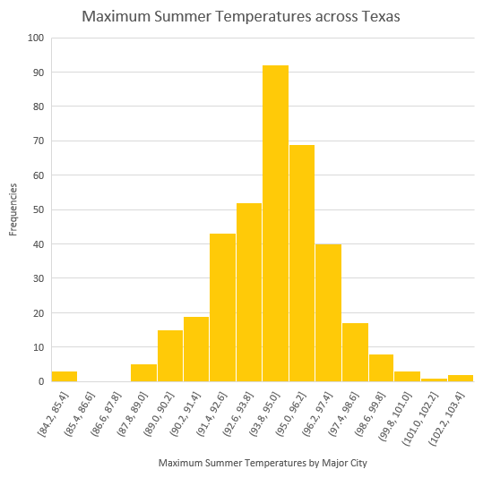
Verifying t-test Requirements
The dependent variable, the maximum summer temperature in each major city in Texas, appears normally distributed. Therefore, the requirement for this t-test has been met.

Slide 7
Descriptive Statistics
 | Results of t-Test
Test statistic (t) | -1.9922
P-value | 0.0471
 | Calculations for t-Test
x (Denton, TX) | 94.1
mu | 94.4
s | 2.52685
n | 369
Degrees of Freedom | 368

Slide 8
Conclusions
x < mu
This means that Denton, TX seems only slightly cooler than the rest of Texas.
P = 0.0471 & alpha = 0.05
0.0471 < 0.05
There is only a 4.71% chance that the null hypothesis is true.
Therefore, there is evidence in favor of rejecting the null hypothesis.
The histogram also shows that Denton, TX has a lower maximum summer temperature than most other major cities in Texas.

